Slide 1
Dependent Clauses I:
Adverbial clauses
Nick Riches
Homework
Homework
Dependent Clauses I: Adverbial clauses
Clauses
Definitions
Unusual types of clauses
What is the purpose of clauses?
So why not just use the term “sentence”?
Dependent (subordinate) versus main clauses
Nick Riches
Adverbial clauses
What is an adverbial clause? Exercise
Newcastle University
Subordinating conjunctions
What is a subordinating conjunction
Subordinating conjunctions and other linking words
The importance of subordinating conjunctions
Compiled on February 17, 2020
Exercise
Exercise
Homework
Homework
1 / 35

Slide 2
Dependent Clauses I:
Adverbial clauses
Nick Riches
Homework
Homework
Homework Clauses
Clauses
Definitions
Unusual types of clauses
What is the purpose of clauses?
So why not just use the term “sentence”?
Dependent (subordinate) versus main clauses
Adverbial clauses Subordinating conjunctions
Adverbial clauses
What is an adverbial clause? Exercise
Exercise Homework
Subordinating conjunctions
What is a subordinating conjunction
Subordinating conjunctions and other linking words
The importance of subordinating conjunctions
Exercise
Exercise
Homework
Homework
1 / 35

Slide 3
Homework
Dependent Clauses I:
Adverbial clauses
Nick Riches
Homework
Homework
Clauses
Definitions
Unusual types of clauses
What is the purpose of clauses?
So why not just use the term “sentence”?
Dependent (subordinate) versus main clauses
When I fall in love, it will be forever
Wherever I lay my hat, that’s my home
Whenever/wherever we’re meant to be together, I’ll be there and you’ll be near
Adverbial clauses
What is an adverbial clause? Exercise
Subordinating conjunctions
What is a subordinating conjunction
Subordinating conjunctions and other linking words
The importance of subordinating conjunctions
Exercise
Exercise
Homework
Homework
2 / 35

Slide 4
Homework
Dependent Clauses I:
Adverbial clauses
Nick Riches
Homework
Homework
Clauses
Definitions
Unusual types of clauses
What is the purpose of clauses?
So why not just use the term “sentence”?
Dependent (subordinate) versus main clauses
1. When
I fall in love
, it will be forever
2. Wherever
I lay my hat
, that’s my home
3. Whenever/wherever we’re meant to be together
, I’ll be
Adverbial clauses
What is an adverbial clause? Exercise
there and you’ll be near
These all contain examples of ADVERBIAL CLAUSES (pink)
Subordinating conjunctions
What is a subordinating conjunction
Subordinating conjunctions and other linking words
The importance of subordinating conjunctions
Exercise
Exercise
Homework
Homework
3 / 35

Slide 5
Dependent Clauses I:
Adverbial clauses
Nick Riches
Homework
Homework
Homework Clauses
Clauses
Definitions
Unusual types of clauses
What is the purpose of clauses?
So why not just use the term “sentence”?
Dependent (subordinate) versus main clauses
Adverbial clauses Subordinating conjunctions
Adverbial clauses
What is an adverbial clause? Exercise
Exercise Homework
Subordinating conjunctions
What is a subordinating conjunction
Subordinating conjunctions and other linking words
The importance of subordinating conjunctions
Exercise
Exercise
Homework
Homework
3 / 35

Slide 6
Definitions
Dependent Clauses I:
Adverbial clauses
Nick Riches
Homework
Homework
Clauses
Definitions
Unusual types of clauses
What is the purpose of clauses?
So why not just use the term “sentence”?
Dependent (subordinate) versus main clauses
A clause is a linguistic unit (phrase) which describes a
situation.
It must have a Verb (to describe the situation), and it must have at least one Argument
If only one argument ⇒ Subject Position.
Typically the verb will carry tense.
Adverbial clauses
What is an adverbial clause? Exercise
Subordinating conjunctions
What is a subordinating conjunction
Subordinating conjunctions and other linking words
The importance of subordinating conjunctions
Exercise
Exercise
Homework
Homework
4 / 35

Slide 7
Definitions
Dependent Clauses I:
Adverbial clauses
Nick Riches
Homework
Homework
Clauses
Definitions
Unusual types of clauses
What is the purpose of clauses?
So why not just use the term “sentence”?
Dependent (subordinate) versus main clauses
For the purposes of this course, a “clause” is indistinguishable from a “sentence”, e.g.
Jack likes cheese
Anita is the coolest person in the universe!
Adverbial clauses
What is an adverbial clause? Exercise
Subordinating conjunctions
What is a subordinating conjunction
Subordinating conjunctions and other linking words
The importance of subordinating conjunctions
Exercise
Exercise
Homework
Homework
5 / 35

Slide 8
Definitions
Dependent Clauses I:
Adverbial clauses
Nick Riches
Homework
Homework
If you wish to count the number of clauses in a sentence count the number of Subject + Verb combinations
Clauses
Definitions
Unusual types of clauses
What is the purpose of clauses?
So why not just use the term “sentence”?
Dependent (subordinate) versus main clauses
(1) Because the administrator I saw last week was ill, they said they would find a new administrator who could help
Adverbial clauses
What is an adverbial clause? Exercise
Subordinating conjunctions
What is a subordinating conjunction
Subordinating conjunctions and other linking words
The importance of subordinating conjunctions
Exercise
Exercise
Homework
Homework
6 / 35

Slide 9
Definitions
Dependent Clauses I:
Adverbial clauses
Nick Riches
Homework
Homework
If you wish to count the number of clauses in a sentence count the number of Subject + Verb combinations
Clauses
Definitions
Unusual types of clauses
What is the purpose of clauses?
So why not just use the term “sentence”?
Dependent (subordinate) versus main clauses
Because the administrator I saw last week was ill, they said they would find a new administrator who could help
Because the administrator [ I saw last week ] was ill,
Adverbial clauses
What is an adverbial clause? Exercise
Subordinating conjunctions
What is a subordinating conjunction
Subordinating conjunctions and other linking words
The importance of subordinating conjunctions
they
said
they
would find a new administrator
who
could hel
p
Exercise
Exercise
Homework
Homework
6 / 35

Slide 10
Unusual types of clauses
Dependent Clauses I:
Adverbial clauses
Nick Riches
Homework
Homework
Clauses
Definitions
Unusual types of clauses
What is the purpose of clauses?
So why not just use the term “sentence”?
Dependent (subordinate) versus main clauses
1. (My) Being rich is not my primary aim in life
Adverbial clauses
What is an adverbial clause? Exercise
Subordinating conjunctions
What is a subordinating conjunction
Subordinating conjunctions and other linking words
The importance of subordinating conjunctions
Exercise
Exercise
Homework
Homework
7 / 35

Slide 11
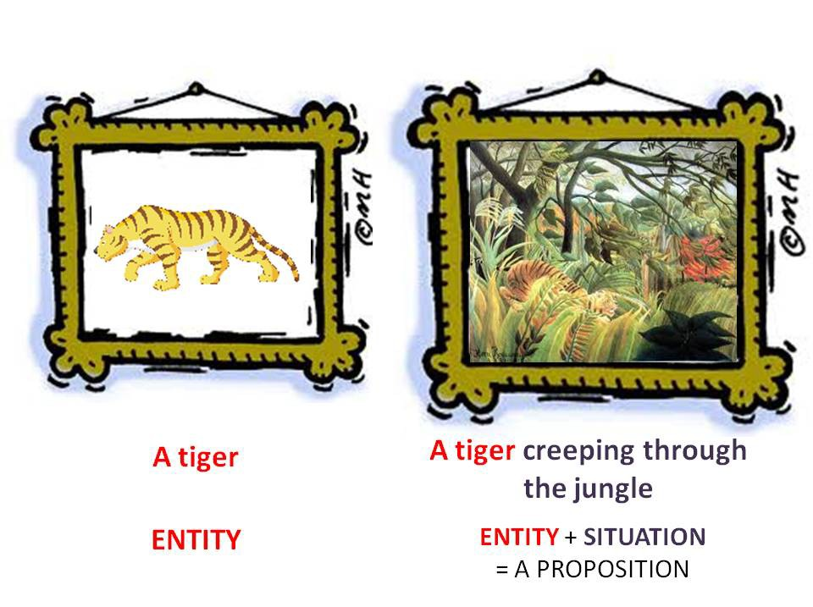
What is the purpose of clauses?
Dependent Clauses I:
Adverbial clauses
Describe SITUATIONS which correspond to SCENES or MENTAL PICTURES.
Nick Riches
Homework
Homework
Clauses
Definitions
Unusual types of clauses
What is the purpose of clauses?
So why not just use the term “sentence”?
Dependent (subordinate) versus main clauses
Adverbial clauses
What is an adverbial clause? Exercise
Subordinating conjunctions
What is a subordinating conjunction
Subordinating conjunctions and other linking words
The importance of subordinating conjunctions
Exercise
Exercise
Homework
Homework
8 / 35

Slide 12
What is the purpose of clauses?
Dependent Clauses I:
Adverbial clauses
Nick Riches
Homework
Homework
Clauses
Definitions
Unusual types of clauses
What is the purpose of clauses?
So why not just use the term “sentence”?
Dependent (subordinate) versus main clauses
Essential to the way we think, express our thoughts, and categorise the world around us.
Without clauses we wouldn’t really be able to communicate.
Adverbial clauses
What is an adverbial clause? Exercise
Subordinating conjunctions
What is a subordinating conjunction
Subordinating conjunctions and other linking words
The importance of subordinating conjunctions
Exercise
Exercise
Homework
Homework
9 / 35

Slide 13
So why not just use the term “sentence”?
Dependent Clauses I:
Adverbial clauses
Nick Riches
Homework
Homework
Clauses come inside sentences
Clauses
Definitions
Unusual types of clauses
What is the purpose of clauses?
So why not just use the term “sentence”?
Dependent (subordinate) versus main clauses
Sentence
Adverbial
Clause
Adverbial clauses
What is an adverbial clause? Exercise
X
Clause
it will be forever
Subordinating conjunctions
What is a subordinating conjunction
Subordinating conjunctions and other linking words
The importance of subordinating conjunctions
When
I fall in love
Exercise
Exercise
Homework
Homework
10 / 35

Slide 14
Dependent (subordinate) versus main clauses
Dependent Clauses I:
Adverbial clauses
Nick Riches
Homework
Homework
Clauses
Definitions
Unusual types of clauses
What is the purpose of clauses?
So why not just use the term “sentence”?
Dependent (subordinate) versus main clauses
Clauses come inside sentences
Sentence
Adverbial
^{Clause} MAIN/MATRIX
Adverbial clauses
What is an adverbial clause? Exercise
X
Clause _{DEP.}
it will be forever
Subordinating conjunctions
What is a subordinating conjunction
Subordinating conjunctions and other linking words
The importance of subordinating conjunctions
When
I fall in love
Exercise
Exercise
Homework
Homework
11 / 35

Slide 15
Dependent Clauses I:
Adverbial clauses
Nick Riches
Homework
Homework
Homework Clauses
Clauses
Definitions
Unusual types of clauses
What is the purpose of clauses?
So why not just use the term “sentence”?
Dependent (subordinate) versus main clauses
Adverbial clauses Subordinating conjunctions
Adverbial clauses
What is an adverbial clause? Exercise
Exercise Homework
Subordinating conjunctions
What is a subordinating conjunction
Subordinating conjunctions and other linking words
The importance of subordinating conjunctions
Exercise
Exercise
Homework
Homework
11 / 35

Slide 16
What is an adverbial clause?
Dependent Clauses I:
Adverbial clauses
Nick Riches
Homework
Homework
When she was challenged about the stolen cake
Dawn | burst | into | tears
Clauses
Definitions
Unusual types of clauses
What is the purpose of clauses?
So why not just use the term “sentence”?
Dependent (subordinate) versus main clauses
Adverbial clause
Clause plus “linking” words (unless, as long as, while, so that, because) takes Adverbial function
Adverbial clauses
What is an adverbial clause? Exercise
Subordinating conjunctions
What is a subordinating conjunction
Subordinating conjunctions and other linking words
The importance of subordinating conjunctions
Exercise
Exercise
Homework
Homework
12 / 35

Slide 17
What is an adverbial clause?
Dependent Clauses I:
Adverbial clauses
Nick Riches
Homework
Homework
When she was challenged about the stolen cake
Dawn | burst | into | tears
Clauses
Definitions
Unusual types of clauses
What is the purpose of clauses?
So why not just use the term “sentence”?
Dependent (subordinate) versus main clauses
Adverbial clause
Clause plus “linking” words (unless, as long as, while, so that, because) takes Adverbial function
Adverbial clauses
What is an adverbial clause? Exercise
Optional (like an adverbial)
Movable (like an adverbial)
Modify the event in the main clause (like an adverbial)
Subordinating conjunctions
What is a subordinating conjunction
Subordinating conjunctions and other linking words
The importance of subordinating conjunctions
Exercise
Exercise
Homework
Homework
12 / 35

Slide 18
What is an adverbial clause?
Dependent Clauses I:
Adverbial clauses
Nick Riches
Homework
Homework
Clauses
Definitions
Unusual types of clauses
What is the purpose of clauses?
So why not just use the term “sentence”?
Dependent (subordinate) versus main clauses
1.
Last weekend
I had a party
Movement
t I had a party last weekend
Adverbial clauses
What is an adverbial clause? Exercise
2.
3. Last weekend I had a party
Subordinating conjunctions
What is a subordinating conjunction
Subordinating conjunctions and other linking words
The importance of subordinating conjunctions
Exercise
Exercise
Homework
Homework
13 / 35

Slide 19
What is an adverbial clause?
Dependent Clauses I:
Adverbial clauses
Nick Riches
Homework
Homework
Clauses
Definitions
Unusual types of clauses
What is the purpose of clauses?
So why not just use the term “sentence”?
Dependent (subordinate) versus main clauses
1.
Because it was raining
the fields were underwater
Movement
t The fields were underwater because it was raining
Adverbial clauses
What is an adverbial clause? Exercise
2.
3. Because it was raining the fields were underwater
Subordinating conjunctions
What is a subordinating conjunction
Subordinating conjunctions and other linking words
The importance of subordinating conjunctions
Exercise
Exercise
Homework
Homework
14 / 35

Slide 20
What is an adverbial clause?
Dependent Clauses I:
Adverbial clauses
Nick Riches
Homework
Homework
Clauses
Definitions
Unusual types of clauses
What is the purpose of clauses?
So why not just use the term “sentence”?
Dependent (subordinate) versus main clauses
1. Don’t say sorry
unless you mean it
Movement
Unless you mean it Don’t say sorry t
Adverbial clauses
What is an adverbial clause? Exercise
2.
3. Don’t say sorry unless you mean it
Subordinating conjunctions
What is a subordinating conjunction
Subordinating conjunctions and other linking words
The importance of subordinating conjunctions
Exercise
Exercise
Homework
Homework
15 / 35

Slide 21
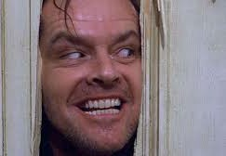
What is an adverbial clause?
Dependent Clauses I:
Adverbial clauses
Because the ADVERBIAL is semantically dependent on the main clause, it cannot stand alone.
The ‘door’ test (Steven McCafferty)
Nick Riches
Homework
Homework
Clauses
Definitions
Unusual types of clauses
What is the purpose of clauses?
So why not just use the term “sentence”?
Dependent (subordinate) versus main clauses
The fields were underwater
Adverbial clauses
What is an adverbial clause? Exercise
You can’t come to the party
Subordinating conjunctions
What is a subordinating conjunction
Subordinating conjunctions and other linking words
The importance of subordinating conjunctions
??? Because it had been raining
Exercise
Exercise
??? Unless you bring strawberries and champage
Homework
Homework
16 / 35

Slide 22
Exercise
Dependent Clauses I:
Adverbial clauses
Nick Riches
Homework
Homework
For the following sentences, identify the dependent and main clauses.
Try to use the following tests
Clauses
Definitions
Unusual types of clauses
What is the purpose of clauses?
So why not just use the term “sentence”?
Dependent (subordinate) versus main clauses
Are they semantically backgrounded? (if yes, they are likely to be a dependent clause)
Are they syntactically optional (if yes, they are likely to be a dependent clause)
Do they pass the “door” test (if no, they are likely to be a dependent clause)
Adverbial clauses
What is an adverbial clause? Exercise
Subordinating conjunctions
What is a subordinating conjunction
Subordinating conjunctions and other linking words
The importance of subordinating conjunctions
Exercise
Exercise
Homework
Homework
17 / 35

Slide 23
Exercise
Dependent Clauses I:
Adverbial clauses
Nick Riches
Homework
Homework
You can’t come to the party unless you bring strawberries and champagne
You can bring books into the exam as long as they are placed on your desks.
While Nancy likes hot food, her partner cannot stand chilli pepper.
Nancy stood on tiptoe so that she could reach the top shelf
As she’d forgotten her kit she couldn’t play football
When she was challenged about the stolen cake Dawn burst into tears.
Clauses
Definitions
Unusual types of clauses
What is the purpose of clauses?
So why not just use the term “sentence”?
Dependent (subordinate) versus main clauses
Adverbial clauses
What is an adverbial clause? Exercise
Subordinating conjunctions
What is a subordinating conjunction
Subordinating conjunctions and other linking words
The importance of subordinating conjunctions
Exercise
Exercise
Homework
Homework
18 / 35

Slide 24
Exercise
Dependent Clauses I:
Adverbial clauses
Nick Riches
Homework
Homework
1. You can’t come to the party
unless you bring strawberries and champagne
Clauses
Definitions
Unusual types of clauses
What is the purpose of clauses?
So why not just use the term “sentence”?
Dependent (subordinate) versus main clauses
2. You can bring books into the exam
as long as they are placed on your desks
3. While Nancy likes hot food
her partner cannot stand chilli pepper
Adverbial clauses
What is an adverbial clause? Exercise
4. Nancy stood on tiptoe
so that she could reach the top shelf
Subordinating conjunctions
What is a subordinating conjunction
Subordinating conjunctions and other linking words
The importance of subordinating conjunctions
5. As she’d forgotten her kit she couldn’t play football
6. When she was challenged about the stolen cake
Dawn burst into tears
Exercise
Exercise
Homework
Homework
19 / 35

Slide 25
Dependent Clauses I:
Adverbial clauses
Nick Riches
Homework
Homework
Homework Clauses
Clauses
Definitions
Unusual types of clauses
What is the purpose of clauses?
So why not just use the term “sentence”?
Dependent (subordinate) versus main clauses
Adverbial clauses Subordinating conjunctions
Adverbial clauses
What is an adverbial clause? Exercise
Exercise Homework
Subordinating conjunctions
What is a subordinating conjunction
Subordinating conjunctions and other linking words
The importance of subordinating conjunctions
Exercise
Exercise
Homework
Homework
19 / 35

Slide 26
What is a subordinating conjunction
Dependent Clauses I:
Adverbial clauses
Nick Riches
Homework
Homework
Clauses
Definitions
Unusual types of clauses
What is the purpose of clauses?
So why not just use the term “sentence”?
Dependent (subordinate) versus main clauses
Sentence
ADVERBIAL
MAIN Clause
Adverbial clauses
What is an adverbial clause? Exercise
SUB.
ADV. Clause
it will be forever
Subordinating conjunctions
What is a subordinating conjunction
Subordinating conjunctions and other linking words
The importance of subordinating conjunctions
When
I fall in love
Exercise
Exercise
Homework
Homework
20 / 35

Slide 27
What is a subordinating conjunction
Dependent Clauses I:
Adverbial clauses
Nick Riches
Homework
Homework
Clauses
Definitions
Unusual types of clauses
What is the purpose of clauses?
So why not just use the term “sentence”?
Dependent (subordinate) versus main clauses
Sentence
MAIN Clause
ADVERBIAL
Adverbial clauses
What is an adverbial clause? Exercise
The fields were wet
SUB
ADV. Clause
because
it was raining
Subordinating conjunctions
What is a subordinating conjunction
Subordinating conjunctions and other linking words
The importance of subordinating conjunctions
Exercise
Exercise
Homework
Homework
21 / 35

Slide 28
What is a subordinating conjunction
Dependent Clauses I:
Adverbial clauses
Nick Riches
Homework
Homework
Clauses
Definitions
Unusual types of clauses
What is the purpose of clauses?
So why not just use the term “sentence”?
Dependent (subordinate) versus main clauses
Sentence
MAIN Clause ADVERBIAL
Adverbial clauses
What is an adverbial clause? Exercise
Don’t say sorry SUB ADV. Clause
unless you mean it
Subordinating conjunctions
What is a subordinating conjunction
Subordinating conjunctions and other linking words
The importance of subordinating conjunctions
Exercise
Exercise
Homework
Homework
22 / 35

Slide 29
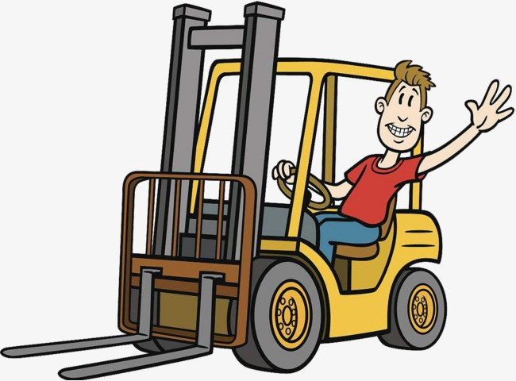
What is a subordinating conjunction
Dependent Clauses I:
Adverbial clauses
Nick Riches
Homework
Homework
Clauses
Definitions
Unusual types of clauses
What is the purpose of clauses?
So why not just use the term “sentence”?
Dependent (subordinate) versus main clauses
Adverbial clauses
What is an adverbial clause? Exercise
Subordinating conjunctions
What is a subordinating conjunction
Subordinating conjunctions and other linking words
The importance of subordinating conjunctions
Exercise
Exercise
Homework
Homework
23 / 35

Slide 30
What is a subordinating conjunction
Dependent Clauses I:
Adverbial clauses
Nick Riches
Homework
Homework
Clauses
Definitions
Unusual types of clauses
What is the purpose of clauses?
So why not just use the term “sentence”?
Dependent (subordinate) versus main clauses
1. He had a good time at the party. He was tired.
2. He had a good time at the party, although he was tired.
3.
Adverbial clauses
What is an adverbial clause? Exercise
Movement
Although he was tired
he had a good time at the party t
Subordinating conjunctions
What is a subordinating conjunction
Subordinating conjunctions and other linking words
The importance of subordinating conjunctions
Exercise
Exercise
Homework
Homework
24 / 35

Slide 31
Subordinating conjunctions and other linking words
Dependent Clauses I:
Adverbial clauses
Nick Riches
Homework
Homework
Clauses
Definitions
Unusual types of clauses
What is the purpose of clauses?
So why not just use the term “sentence”?
Dependent (subordinate) versus main clauses
Although he was tired, he had a good time at the party. He had a good time at the party, although he was tired. SUBORDINATING CONJUNCTION
He was tired, but he had a good time at the party.
Adverbial clauses
What is an adverbial clause? Exercise
3. He was tired. However, he had a good time at the party.
Subordinating conjunctions
What is a subordinating conjunction
Subordinating conjunctions and other linking words
The importance of subordinating conjunctions
Exercise
Exercise
Homework
Homework
25 / 35

Slide 32
Subordinating conjunctions and other linking words
Dependent Clauses I:
Adverbial clauses
Nick Riches
Homework
Homework
Clauses
Definitions
Unusual types of clauses
What is the purpose of clauses?
So why not just use the term “sentence”?
Dependent (subordinate) versus main clauses
Although he was tired, he had a good time at the party. He had a good time at the party, although he was tired. SUBORDINATING CONJUNCTION
He was tired, but he had a good time at the party. COORDINATING CONJUNCTION
He was tired. However, he had a good time at the party.
Adverbial clauses
What is an adverbial clause? Exercise
Subordinating conjunctions
What is a subordinating conjunction
Subordinating conjunctions and other linking words
The importance of subordinating conjunctions
Exercise
Exercise
Homework
Homework
25 / 35

Slide 33
Subordinating conjunctions and other linking words
Dependent Clauses I:
Adverbial clauses
Nick Riches
Homework
Homework
Clauses
Definitions
Unusual types of clauses
What is the purpose of clauses?
So why not just use the term “sentence”?
Dependent (subordinate) versus main clauses
Although he was tired, he had a good time at the party. He had a good time at the party, although he was tired. SUBORDINATING CONJUNCTION
He was tired, but he had a good time at the party. COORDINATING CONJUNCTION
He was tired. However, he had a good time at the party. ADVERB
Adverbial clauses
What is an adverbial clause? Exercise
Subordinating conjunctions
What is a subordinating conjunction
Subordinating conjunctions and other linking words
The importance of subordinating conjunctions
Exercise
Exercise
Homework
Homework
25 / 35

Slide 34
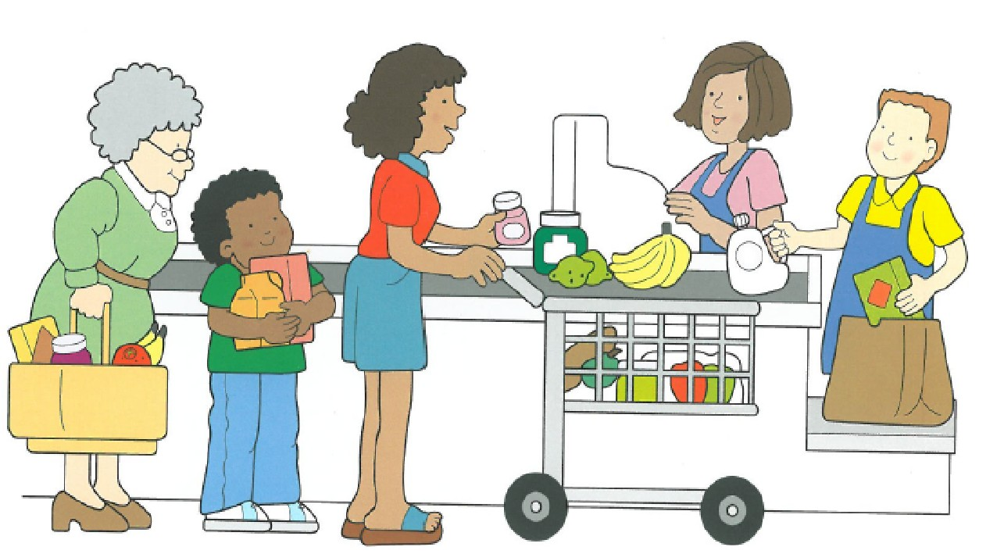
The importance of subordinating conjunctions
Dependent Clauses I:
Adverbial clauses
Useful devices for linking events in a narrative.
Assessed in many language assessments, e.g. the Formulating Sentences subtest of the CELF.
Nick Riches
Homework
Homework
Clauses
Definitions
Unusual types of clauses
What is the purpose of clauses?
So why not just use the term “sentence”?
Dependent (subordinate) versus main clauses
Adverbial clauses
What is an adverbial clause? Exercise
Subordinating conjunctions
What is a subordinating conjunction
Subordinating conjunctions and other linking words
The importance of subordinating conjunctions
Exercise
Exercise
Homework
Homework
26 / 35

Slide 35
The importance of subordinating conjunctions
Dependent Clauses I:
Adverbial clauses
Nick Riches
Homework
Homework
Clauses
Definitions
Unusual types of clauses
What is the purpose of clauses?
So why not just use the term “sentence”?
Dependent (subordinate) versus main clauses
Language impaired individuals have great difficulties using subordinating conjunctions to introduce adverbial clauses.
They have lower clausal density (number of clauses per sentence)
Adverbial clauses
What is an adverbial clause? Exercise
Subordinating conjunctions
What is a subordinating conjunction
Subordinating conjunctions and other linking words
The importance of subordinating conjunctions
Exercise
Exercise
Homework
Homework
27 / 35

Slide 36
Dependent Clauses I:
Adverbial clauses
Nick Riches
Homework
Homework
Homework Clauses
Clauses
Definitions
Unusual types of clauses
What is the purpose of clauses?
So why not just use the term “sentence”?
Dependent (subordinate) versus main clauses
Adverbial clauses Subordinating conjunctions
Adverbial clauses
What is an adverbial clause? Exercise
Exercise Homework
Subordinating conjunctions
What is a subordinating conjunction
Subordinating conjunctions and other linking words
The importance of subordinating conjunctions
Exercise
Exercise
Homework
Homework
27 / 35

Slide 37
Exercise
Dependent Clauses I:
Adverbial clauses
Nick Riches
Homework
Homework
Clauses
Definitions
Unusual types of clauses
What is the purpose of clauses?
So why not just use the term “sentence”?
Dependent (subordinate) versus main clauses
For the following sentences:
Link them using a subordinating conjunction.
Do tests for the adverbial phrase (the movement test and “door” test)
Try to rewrite the sentence using either an adverb or a coordinating conjunction (not always possible)
Adverbial clauses
What is an adverbial clause? Exercise
Subordinating conjunctions
What is a subordinating conjunction
Subordinating conjunctions and other linking words
The importance of subordinating conjunctions
Exercise
Exercise
Homework
Homework
28 / 35

Slide 38
Exercise
Dependent Clauses I:
Adverbial clauses
Nick Riches
Homework
Homework
Clauses
Definitions
Unusual types of clauses
What is the purpose of clauses?
So why not just use the term “sentence”?
Dependent (subordinate) versus main clauses
Touch that wire. You will be electrocuted.
Jack did not study very hard. He failed the exam.
Max can come to the party. He promises to behave himself.
Janice and Elena were on holiday. Their house was being burgled.
Jack added salt and pepper. The food tasted better.
Adverbial clauses
What is an adverbial clause? Exercise
Subordinating conjunctions
What is a subordinating conjunction
Subordinating conjunctions and other linking words
The importance of subordinating conjunctions
Exercise
Exercise
Homework
Homework
29 / 35

Slide 39
Exercise
Dependent Clauses I:
Adverbial clauses
Nick Riches
Homework
Homework
Clauses
Definitions
Unusual types of clauses
What is the purpose of clauses?
So why not just use the term “sentence”?
Dependent (subordinate) versus main clauses
If you touch that wire
you will be electrocuted.
You will be electrocuted
if you touch that wire
Adverbial clauses
What is an adverbial clause? Exercise
Subordinating conjunctions
What is a subordinating conjunction
Subordinating conjunctions and other linking words
The importance of subordinating conjunctions
Exercise
Exercise
Homework
Homework
30 / 35

Slide 40
Exercise
Dependent Clauses I:
Adverbial clauses
Nick Riches
Homework
Homework
Clauses
Definitions
Unusual types of clauses
What is the purpose of clauses?
So why not just use the term “sentence”?
Dependent (subordinate) versus main clauses
Since/as/because Jack did not study hard
he failed the
exam
He failed the exam
Since/as/because he did not study hard
Adverbial clauses
What is an adverbial clause? Exercise
He did not study hard. Therefore/Consequently he failed the exam.
He did not study hard, so he failed the exam.
Subordinating conjunctions
What is a subordinating conjunction
Subordinating conjunctions and other linking words
The importance of subordinating conjunctions
Exercise
Exercise
Homework
Homework
31 / 35

Slide 41
Exercise
Dependent Clauses I:
Adverbial clauses
Nick Riches
Homework
Homework
Clauses
Definitions
Unusual types of clauses
What is the purpose of clauses?
So why not just use the term “sentence”?
Dependent (subordinate) versus main clauses
Max can come to the party
if/as long as/provided that he behaves himself
If/as long as/provided that he behaves himself
Max can
Adverbial clauses
What is an adverbial clause? Exercise
come to the party.
Subordinating conjunctions
What is a subordinating conjunction
Subordinating conjunctions and other linking words
The importance of subordinating conjunctions
Exercise
Exercise
Homework
Homework
32 / 35

Slide 42
Exercise
Dependent Clauses I:
Adverbial clauses
Nick Riches
Homework
Homework
Clauses
Definitions
Unusual types of clauses
What is the purpose of clauses?
So why not just use the term “sentence”?
Dependent (subordinate) versus main clauses
While/when Janice and Elena were on holiday
their house
was being burgled.
Their house was being burgled
while/when Janice and Elena were on holiday
Adverbial clauses
What is an adverbial clause? Exercise
Janice and Elena were on holiday. Meanwhile their house was being burgled.
Subordinating conjunctions
What is a subordinating conjunction
Subordinating conjunctions and other linking words
The importance of subordinating conjunctions
Exercise
Exercise
Homework
Homework
33 / 35

Slide 43
Exercise
Dependent Clauses I:
Adverbial clauses
Nick Riches
Homework
Homework
Clauses
Definitions
Unusual types of clauses
What is the purpose of clauses?
So why not just use the term “sentence”?
Dependent (subordinate) versus main clauses
Because Jack added salt
the food tasted better
The food tasted better because Jack added salt Jack added salt.
Adverbial clauses
What is an adverbial clause? Exercise
Therefore/consequently the food tasted better.
Jack added salt so the food would taste better
Subordinating conjunctions
What is a subordinating conjunction
Subordinating conjunctions and other linking words
The importance of subordinating conjunctions
Exercise
Exercise
Homework
Homework
34 / 35

Slide 44
Dependent Clauses I:
Adverbial clauses
Nick Riches
Homework
Homework
Homework Clauses
Clauses
Definitions
Unusual types of clauses
What is the purpose of clauses?
So why not just use the term “sentence”?
Dependent (subordinate) versus main clauses
Adverbial clauses Subordinating conjunctions
Adverbial clauses
What is an adverbial clause? Exercise
Exercise Homework
Subordinating conjunctions
What is a subordinating conjunction
Subordinating conjunctions and other linking words
The importance of subordinating conjunctions
Exercise
Exercise
Homework
Homework
34 / 35

Slide 45
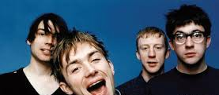
Homework
Dependent Clauses I:
Adverbial clauses
How many finite clauses in the following lyrics from the Blur song “Girls and Boys”?
(We’re) looking for. . .
Girls who are boys Who like boys to be girls Who do boys like they’re girls Who do girls like they’re boys Always should be someone you really love
Nick Riches
Homework
Homework
Clauses
Definitions
Unusual types of clauses
What is the purpose of clauses?
So why not just use the term “sentence”?
Dependent (subordinate) versus main clauses
Adverbial clauses
What is an adverbial clause? Exercise
Subordinating conjunctions
What is a subordinating conjunction
Subordinating conjunctions and other linking words
The importance of subordinating conjunctions
Exercise
Exercise
Homework
Homework
35 / 35

